Slide 1
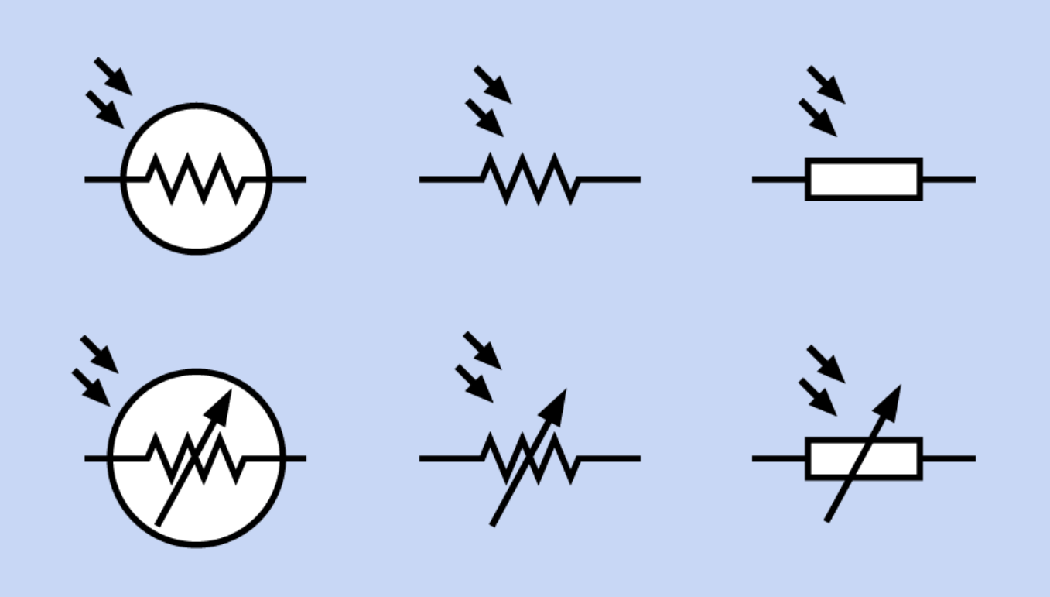

Slide 2
Photoresistance vs. Illumination (linear scale)
Photoresistance vs. Illumination (log-log scale)

Slide 3
Photoresistance vs. Illumination (linear scale)
Photoresistance vs. Illumination (log-log scale)
Full moon, clear sky
Lux = 0.3
Overcast day
Lux = 1,000
Full moon, clear sky
Lux = 0.3
Indoor Room Lighting
Lux = 50
Dark overcast day
Lux = 100
Overcast day
Lux = 1,000
Indoor Room Lighting
Lux = 50
Dark overcast day
Lux = 100

Slide 4
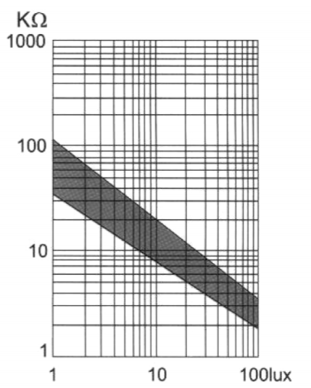
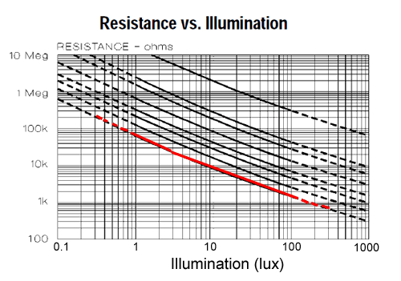
Resistance vs. Illumination

Slide 5
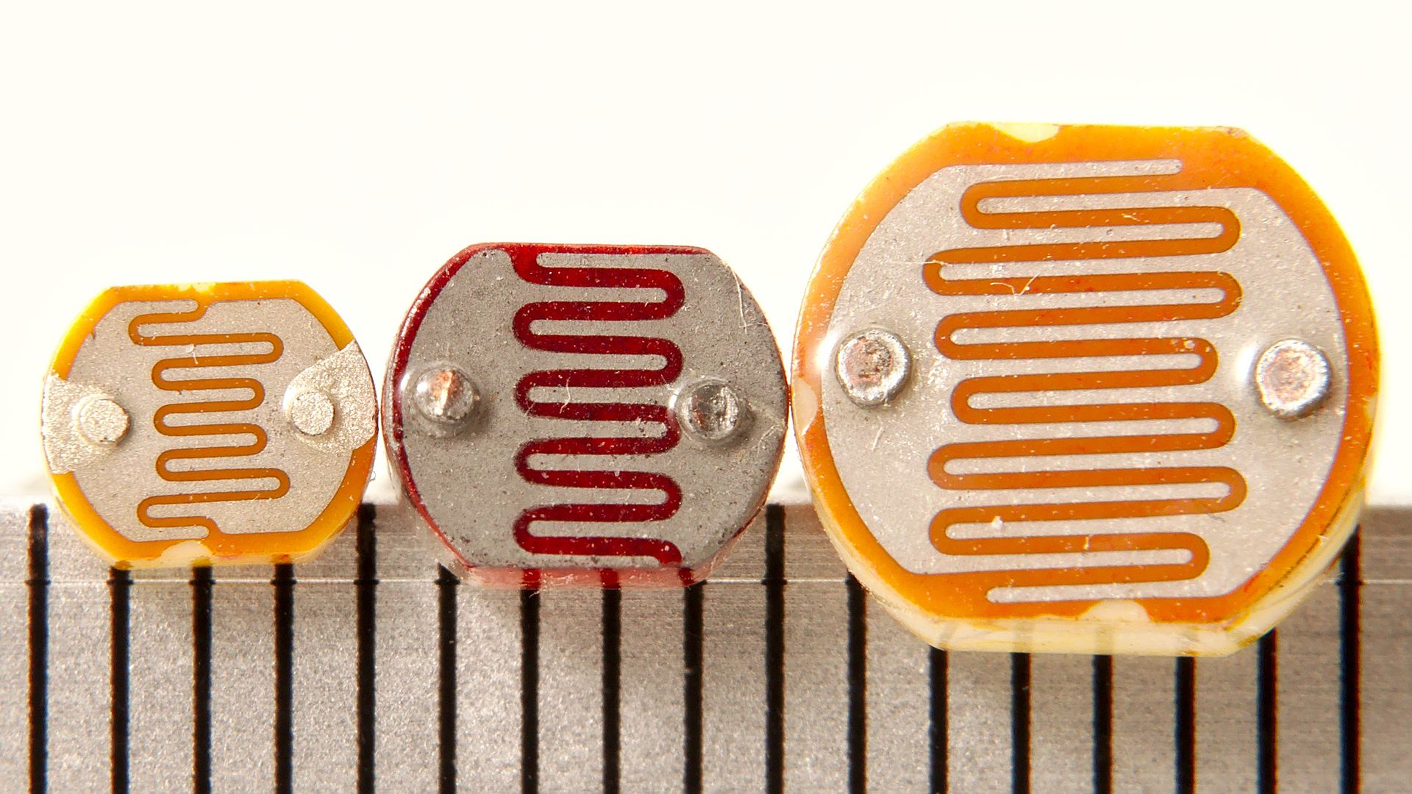

Slide 6
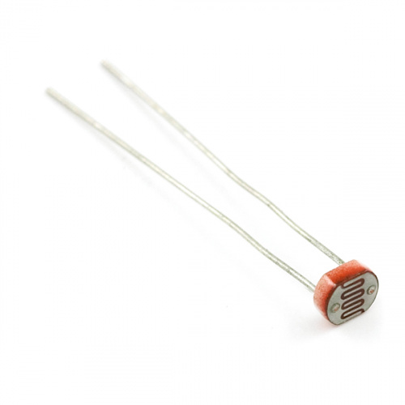

Slide 7
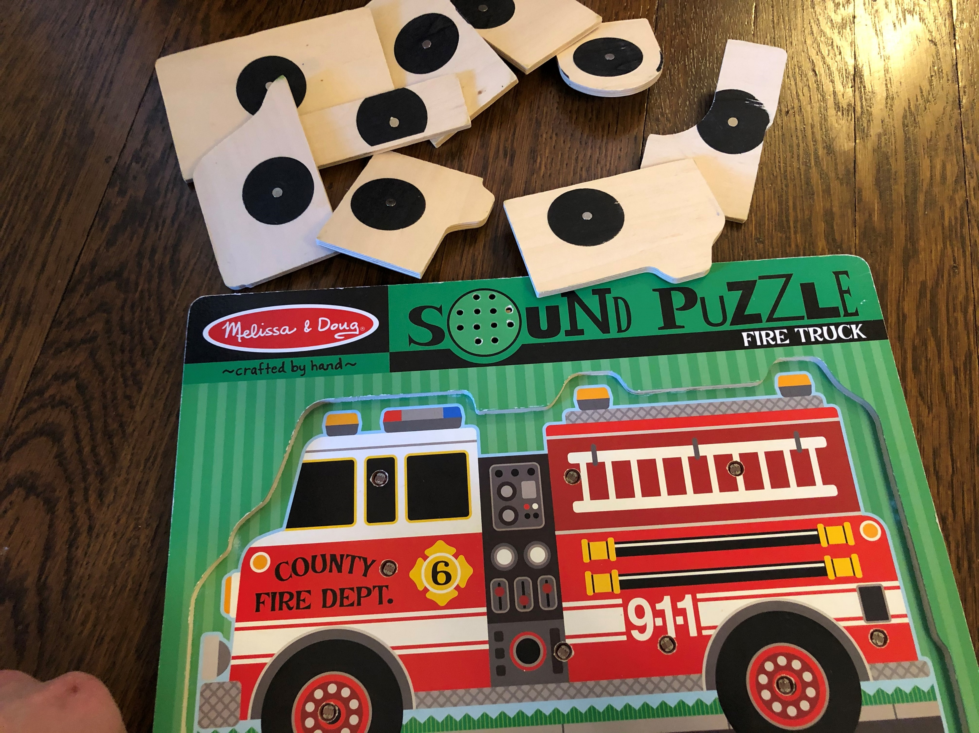
Photoresistors
(One per puzzle piece location to sense when a piece has been placed and puzzle is completed)

Slide 8
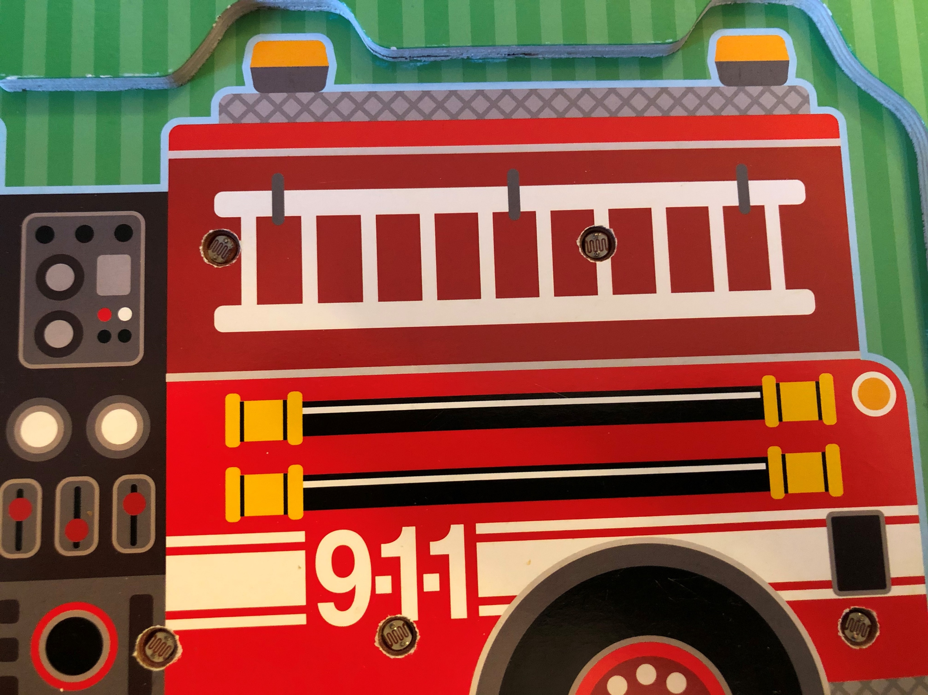
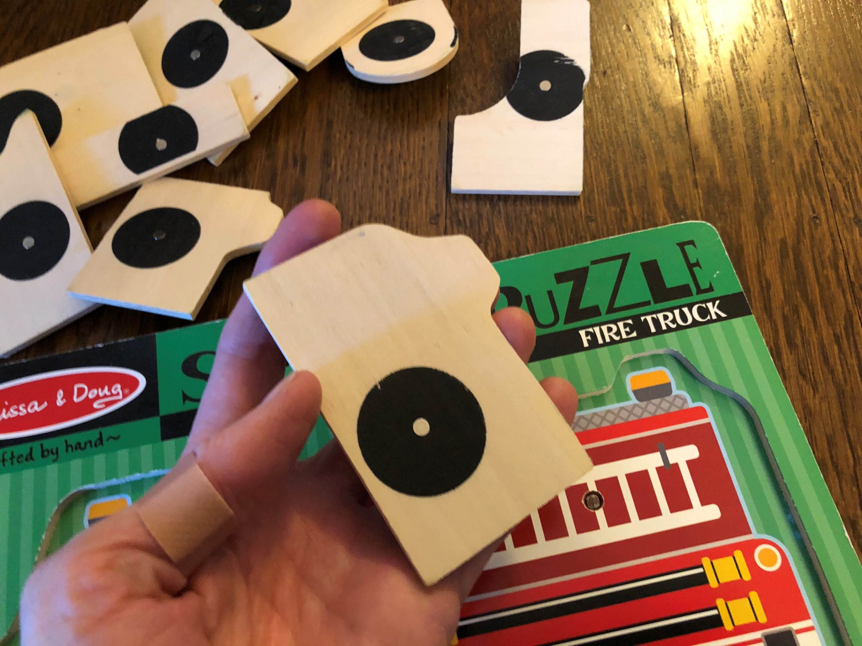
Photoresistors
One photoresistor per puzzle piece location to sense when a piece has been placed and when puzzle is completed

Slide 9
5V
R_{x}
R_{fsr}
Input pin A0
GND

Slide 10
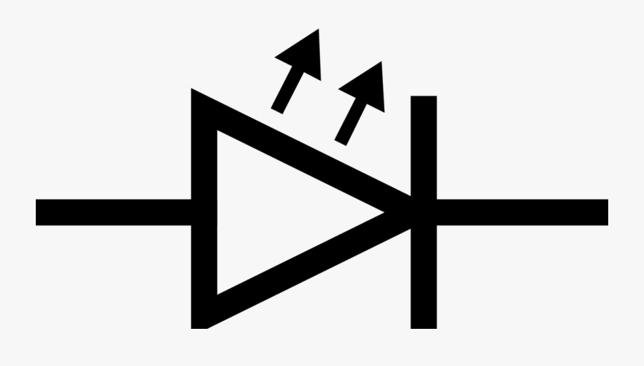

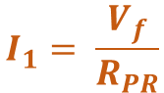
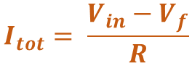
V_{in}
$$I_{tot}= \frac{V_{in}−V_{f}}{R}$$
$$I_{2}=I_{tot}−I_{1}$$
R
$$I_{1}= \frac{V_{f}}{R_{PR}}$$
R_{PR}
V_{f} = 2V
GND
GND
Notes:
https://electronics.stackexchange.com/questions/431334/parallel-circuit-with-led-on-one-path-and-resistor-on-the-other

Slide 11
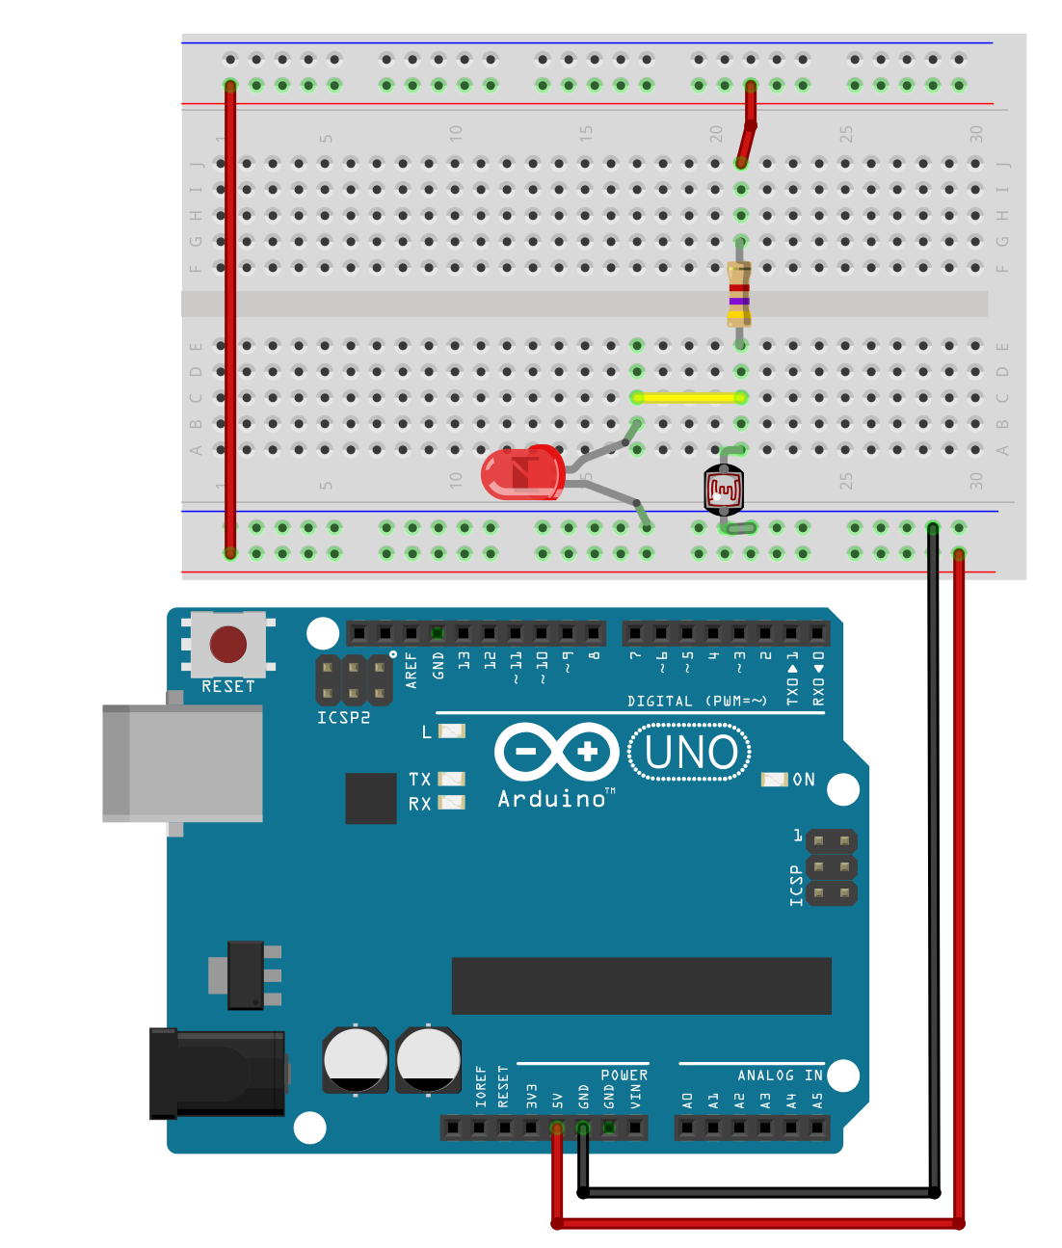
V_{in} = 5V
$$I_{tot}= \frac{V_{in}−V_{f}}{R}$$
$$I_{2}=I_{tot}−I_{1}$$
R
$$I_{1}= \frac{V_{f}}{R_{PR}}$$
R_{PR}
V_{f} = 2V*
GND
GND
* This is a simplification because V_{f} will change with current based on the LED’s I/V curve.
Notes:
https://electronics.stackexchange.com/questions/431334/parallel-circuit-with-led-on-one-path-and-resistor-on-the-other

Slide 12
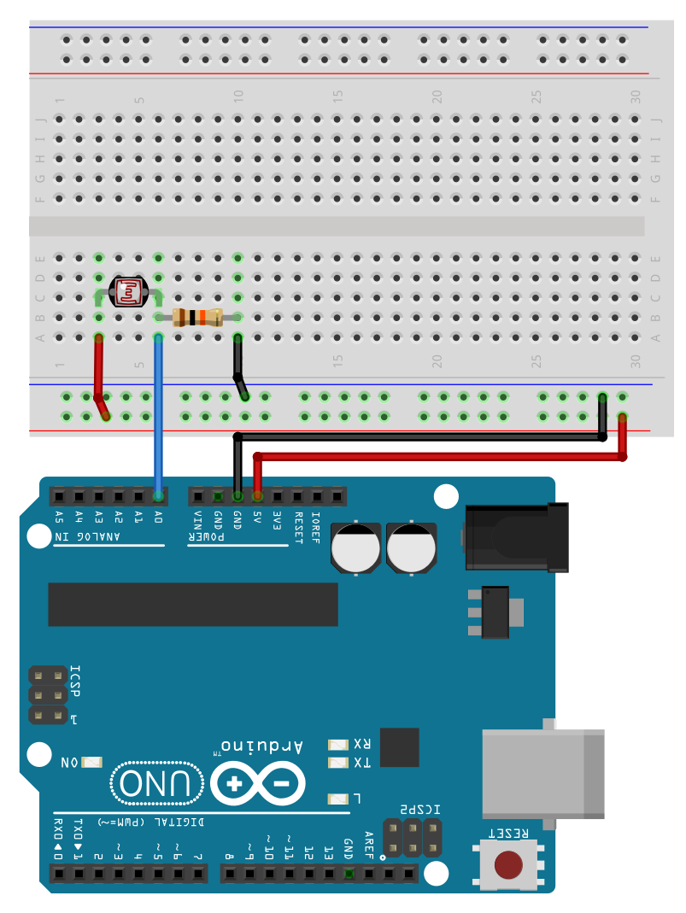
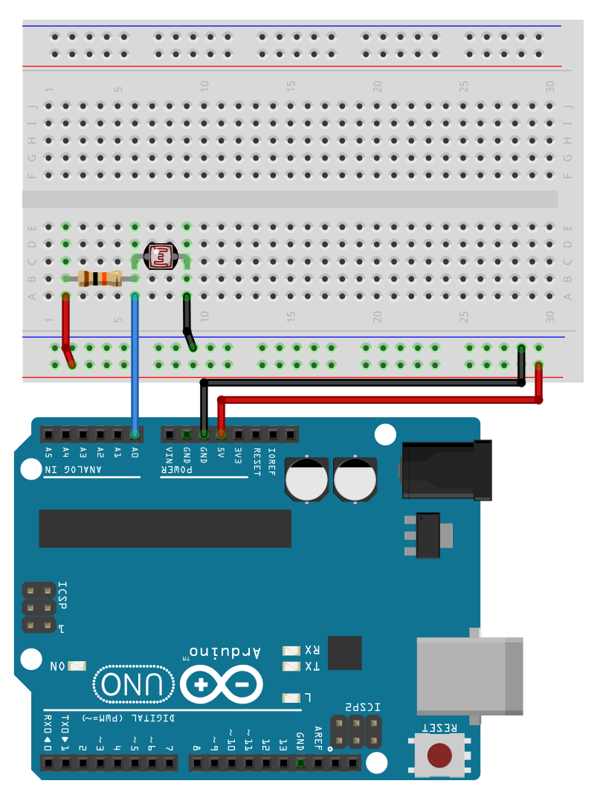
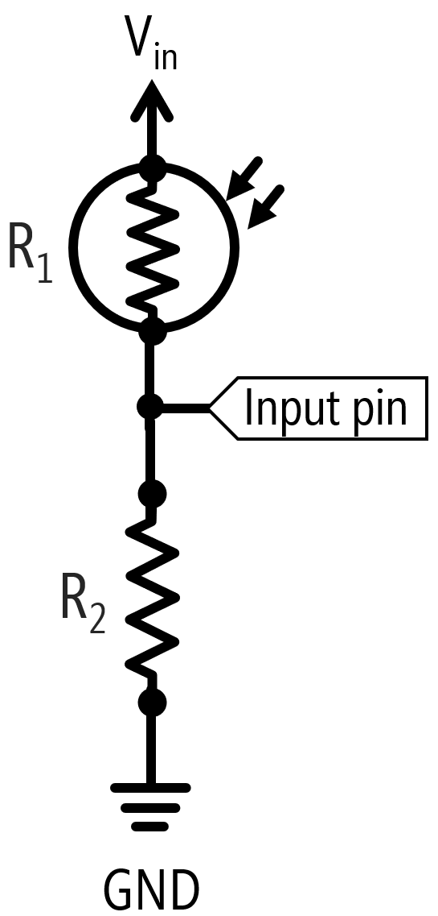
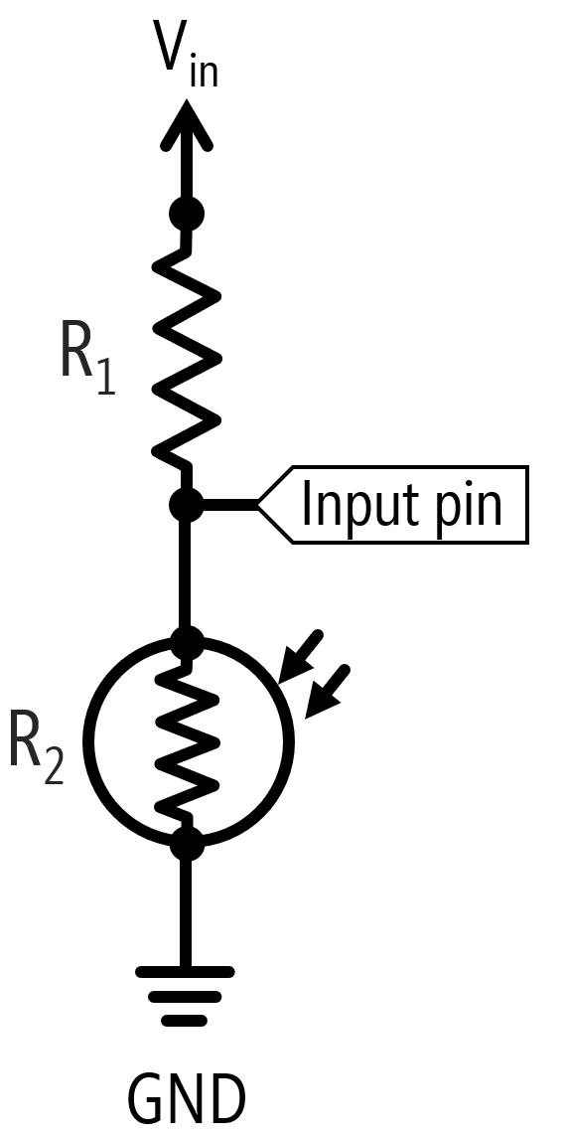

“Lightness” Sensor Configuration
V_{out} increases as light levels on the photoresistor increase
“Darkness” Sensor Configuration
V_{out} increases as light levels on the photoresistor decrease
$$Vout=V_{in}∗\frac{R2}{R1+R2}$$
$$Vout=V_{in}∗\frac{R2}{R1+R2}$$

Slide 13
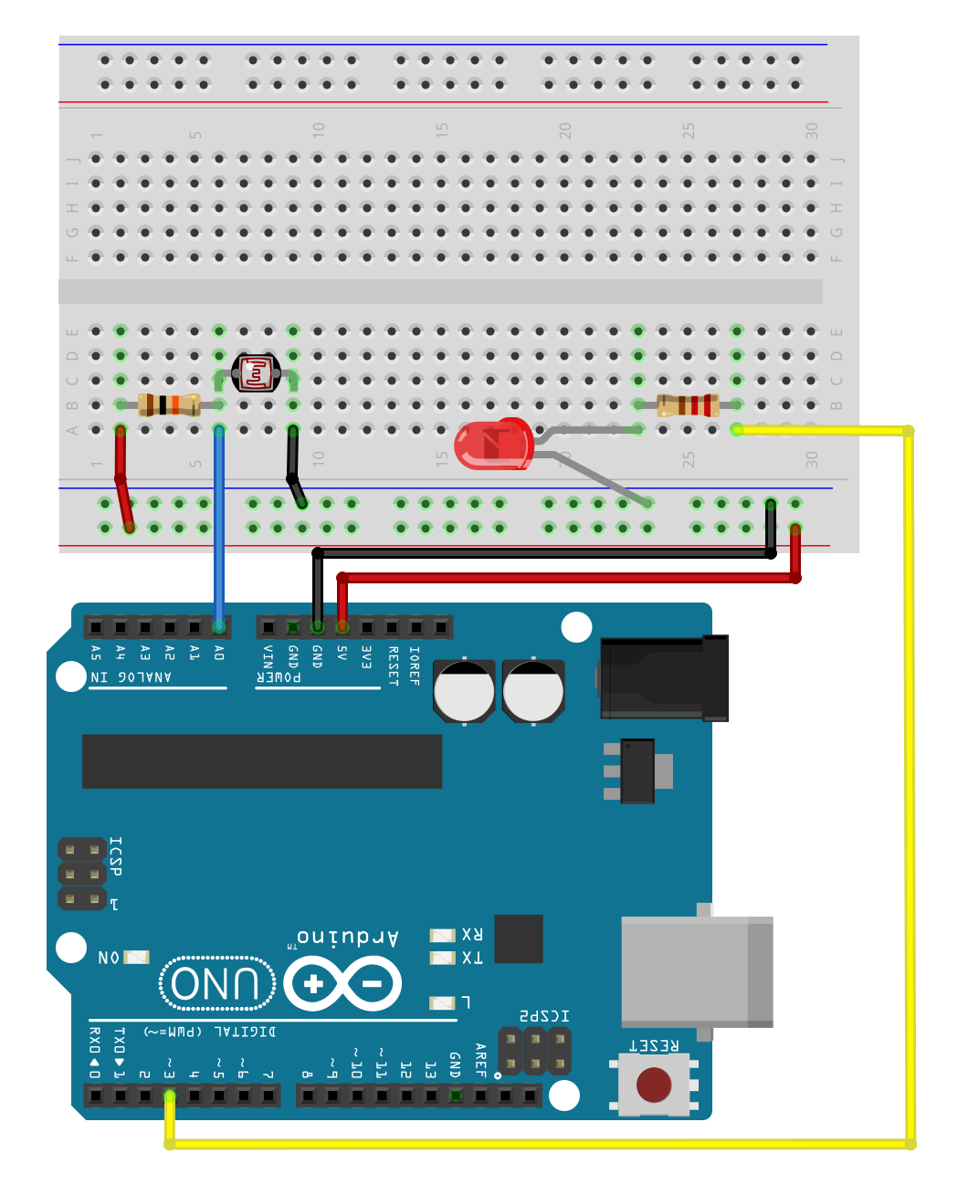
10kΩ
220Ω

Slide 14
V_{in}
R₁
Input pin
R₂
GND
Notes:
With 1k fixed resistor, Vout is 0.45V to 4.95V when the photoresistor is 100ohm to 10k and Vout is 4.99V at 50k and 5V at 100k
With a 10k fixed resistor, Vout is 0.10V to 3.40V when the photoresistor is 100ohm to 10k and Vout is 4.57V at 50k and 4.7V at 100k

Slide 16
Bright Room
R_{photocell}=700Ω
Dim Room
R_{photocell}=10kΩ

Slide 19
V_{in}
R₁
Input pin
R₂
GND

